Slide 1
Mixtures and solutions
Year 7 Science

Slide 2

Review
Explain how Archimedes determined that the King’s crown was not pure gold.
What does displacement mean?
Will a boat float higher in fresh or salt water?
When salt is dissolved in water, can you still see it?

Slide 3
Learning Intentions
Mixtures, including solutions, contain a combination of pure substances that can be separated using a range of techniques.

Slide 4
Success criteria
Compare pure substances and mixtures.
Describe solutions as a special type of mixture.
List features of solutions.

Slide 6
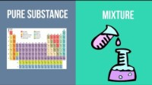

Slide 7
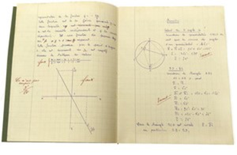
Solutions 6/05/2024
Solutions are mixtures that are uniform and transparent.
The solute is dissolved in the solvent and can be described as soluble, eg sugar is soluble in water.
An insoluble substance will not form a solution, but when mixed will form a suspension, eg chalk is insoluble in water.

Slide 8
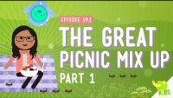

Slide 9
Activity: Solutions worksheet

Slide 10
Success criteria
Compare pure substances and mixtures.
Describe solutions as a special type of mixture.
List features of solutions.

